Slide 1
English Inventions
-in 19th century-

Slide 2
What are English Inventions?
English inventions and discoveries are objects, processes or techniques invented or discovered by a person born in England.
Often, things discovered for the first time are also called "inventions", and in many cases, there is no clear line between the two.

Slide 3
Some of English inventions
Year
What was invented and by who?
1800
1810
1814
Count Alessandro Volta invents the battery
German, Frederick Koenig invents an improved printing press.
Joseph Nicéphore Niépce was the first person to take a photograph.

Slide 4
Year
What was invented and by who?
1819
1825
1827
1838
René Laënnec invents the stethoscope.
William Sturgeon invented the electromagnet.
Charles Wheatstone invents the microphone.
Samual Morse invents Morse Code.

Slide 5
Year
What was made and by who
1854
1861
1866
1885
American, Elias Howe invents a sewing machine.
Pierre Michaux invents a bicycle.
Alfred Nobel invents dynamite.
Karl Benz invents the first practical automobile to be powered by an internal-combustion engine.

Slide 6
Year
What was invented and by who
1888
1893
1898
1899
Nikola Tesla invents the AC motor and transformer.
American, W.L. Judson invents the zipper.
Edwin Prescott patents the roller coaster.
J.S. Thurman patents the motor-driven vacuum cleaner.

Slide 7
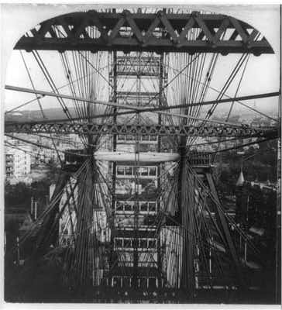
The History of Theme Park Inventions - The Ferris Wheel

Slide 8
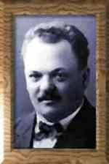
Zipper maker

Slide 9
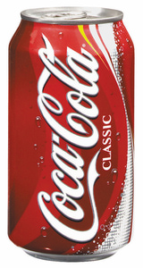
John Pemberton invents Coca Cola.

Slide 10
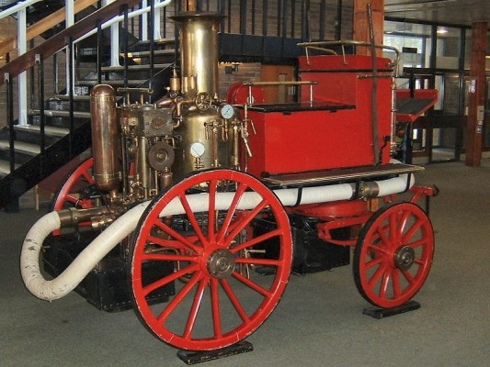
Steam Power Engine

Slide 11
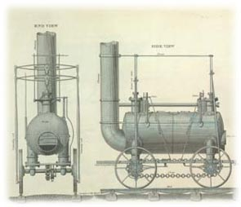

Slide 12
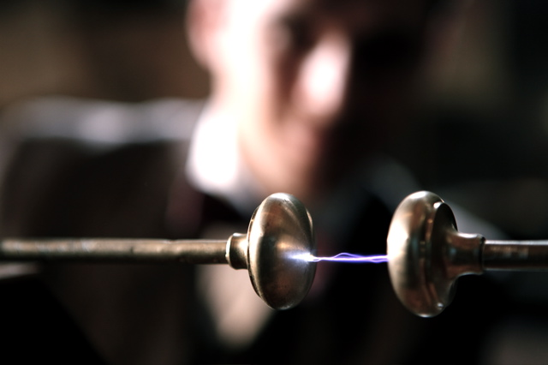

Slide 13
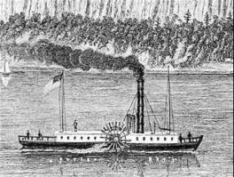
Steamboats

Slide 14
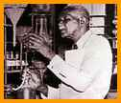
CARVER, GEORGE WASHINGTON
Carver developed hundreds of products from peanuts, sweet potatoes, pecans, and soybeans

Slide 15
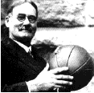
NAISMITH, JAMES
James Naismith (1861-1939) was a Canadian physical education instructor who invented the game of basketball in 1891.

Slide 16
Joseph Gayetty invented toilet paper in 1857.

